Slide 1
Canadian Hydrographic Service
Oceans Protection Plan
Survey planning
2019-20
USCHC - March 2019

Slide 2
Planning
Entering third year of the five-year Oceans Protection Plan (OPP)
2019-2020: approximately $12M surveys under contract ($10M OPP Nearshore + $2M OPP Arctic)
Money and contracts managed regionally
~10 contracts per year (across Canada)
5 companies qualified for LiDAR work
18 companies qualified for multibeam work
USCHC - March 2019

Slide 3
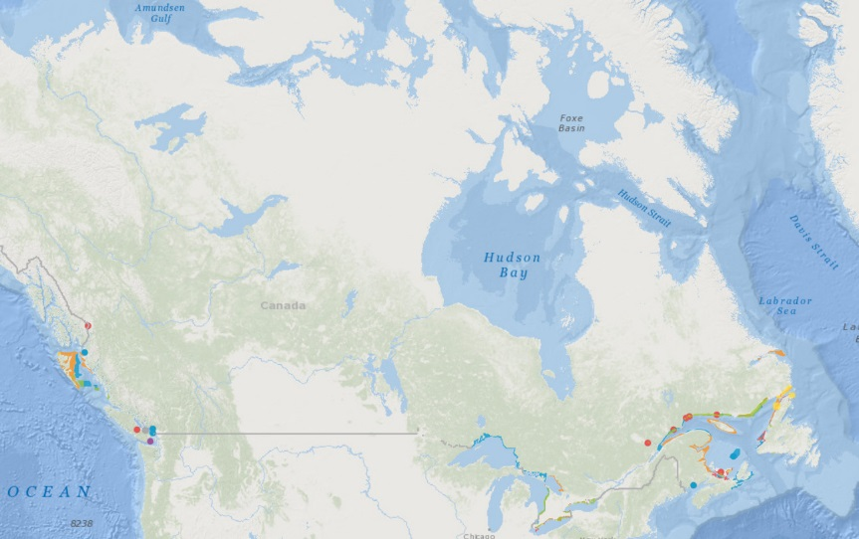
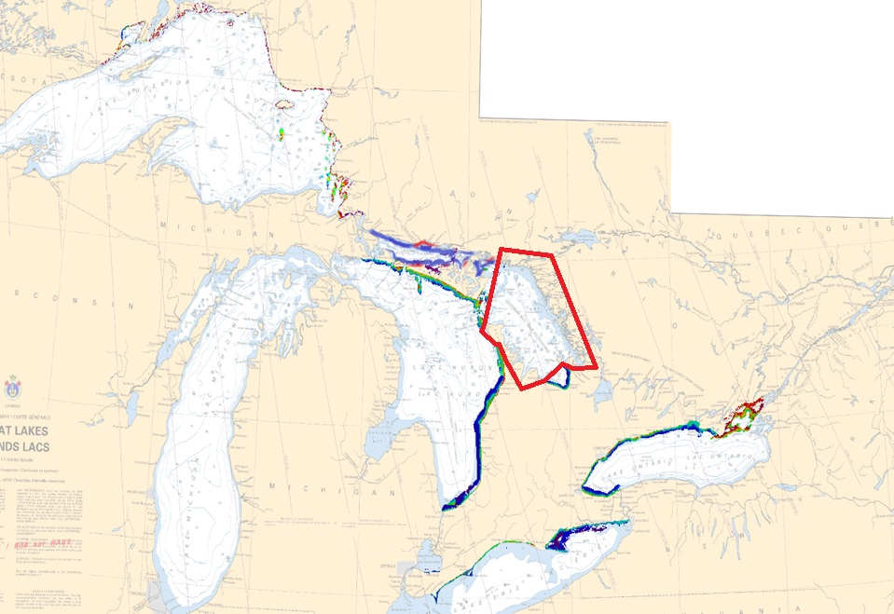
LiDAR – Great Lakes
Oceans Protection Plan
Projected surveys
2019-20
USCHC - March 2019

Slide 4
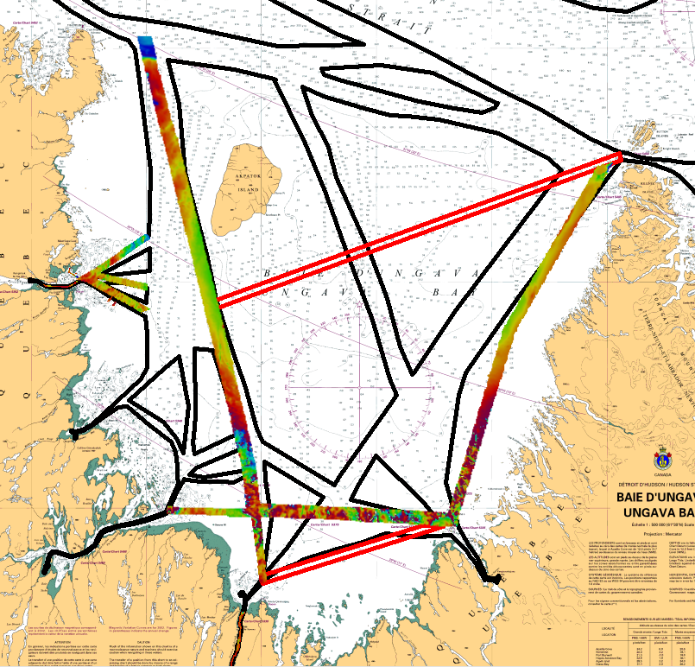
Multibeam – Ungava Bay (red polygons)
Oceans Protection Plan
Projected surveys
2019-20
USCHC - March 2019

Slide 5
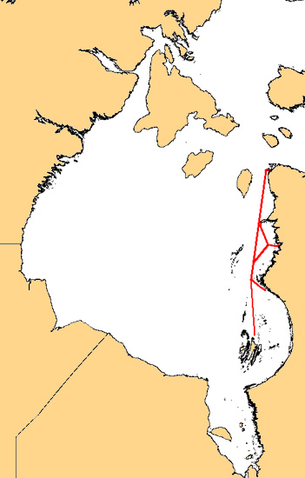
Multibeam – Hudson Bay
Oceans Protection Plan
Projected surveys
2019-20
USCHC - March 2019

Slide 6
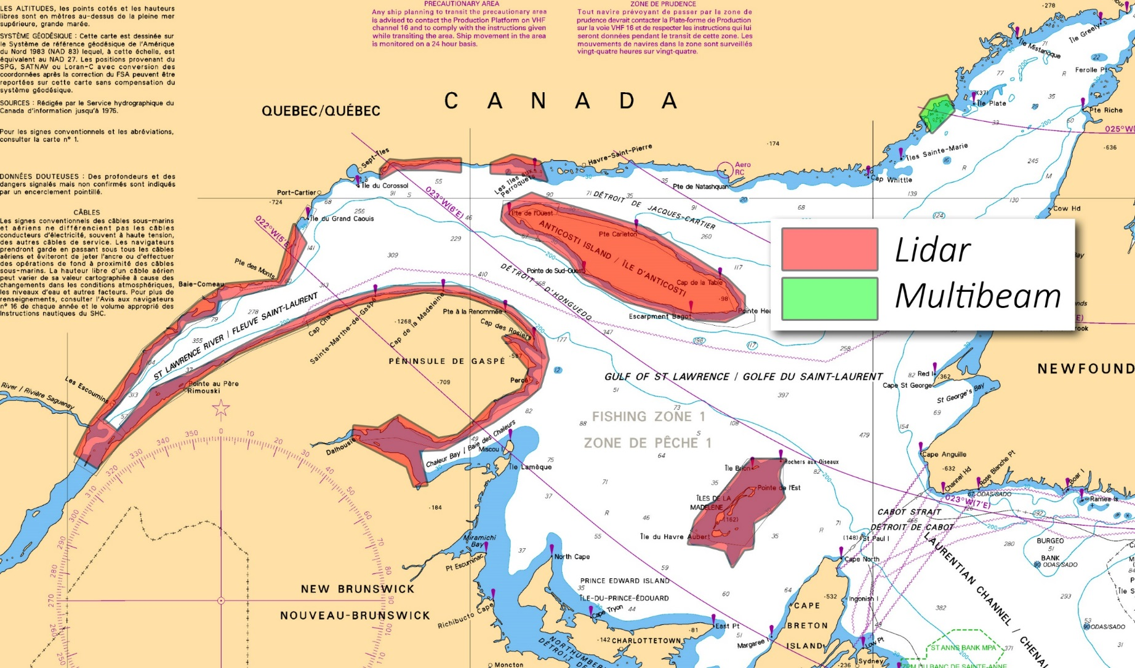
LiDAR & Multibeam– Estuary & Gulf of St-Lawrence
Oceans Protection Plan
Projected surveys
2019-20
USCHC - March 2019

Slide 7
Multibeam– Atlantic Coast
Oceans Protection Plan
Projected surveys
2019-20
USCHC - March 2019

Slide 8
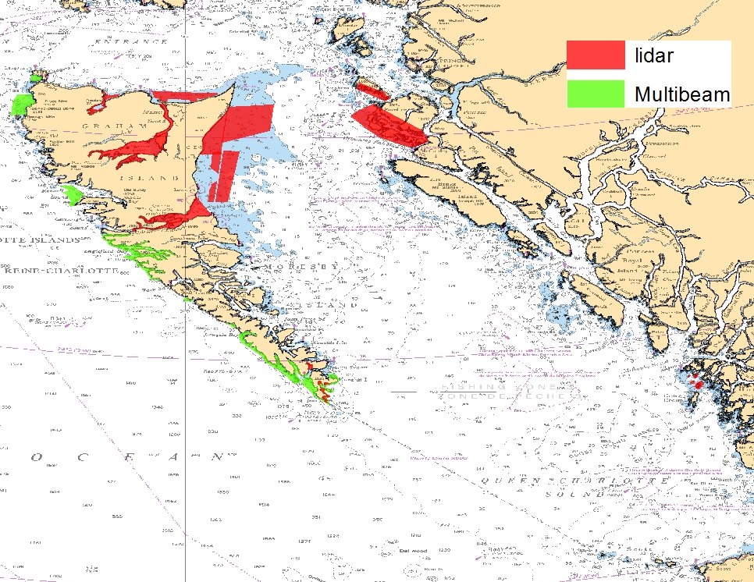
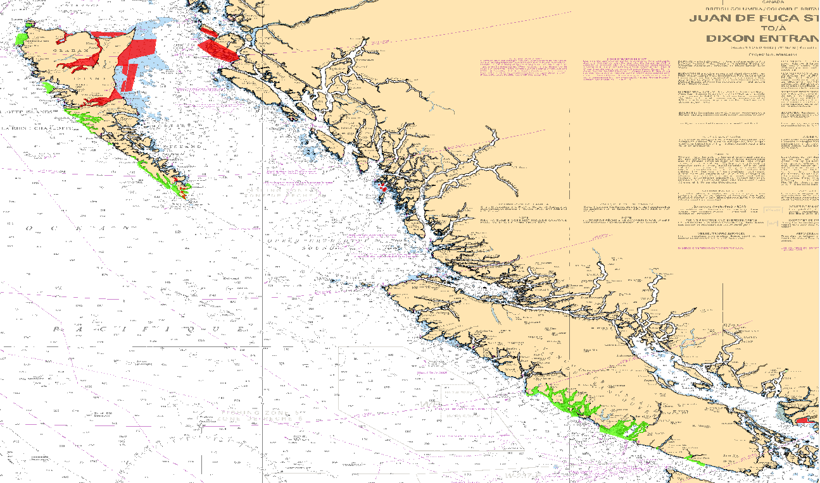
LiDAR & Multibeam– Pacific Coast
Oceans Protection Plan
Projected surveys
2019-20
USCHC - March 2019

Slide 9
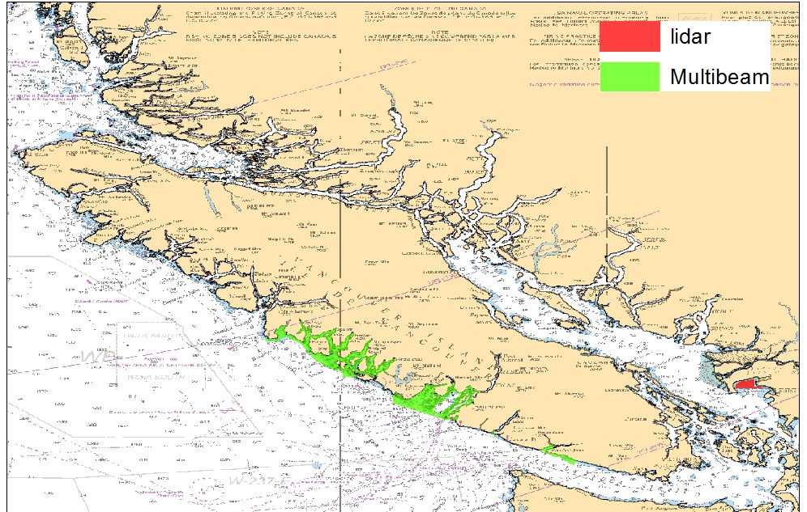
LiDAR & Multibeam– Pacific Coast
Oceans Protection Plan
Projected surveys
2019-20
USCHC - March 2019

